Slide 1


HVHP Institute of Post Graduate Studies
and Research, Kadi
(A Constituent Institute of Kadi Sarva Vishwavidyalaya, Gandhinagar)
Mr. ViralKUMAR A. Patel
Dienone Phenol
Rearrangement reaction

Slide 2
Types of rearrangement reaction
Hofmann rearrangement
Beckmann rearrangement
Benzilic acid rearrangement
Claisen rearrangement
Fries rearrangement
Dienone Phenol rearrangement
Wagner–Meerwein rearrangement
Curtius rearrangement
Schmidt reaction
Favorskii rearrangement

Slide 3
Content
Introduction
General Reaction,
Mechanism
Applications

Slide 4
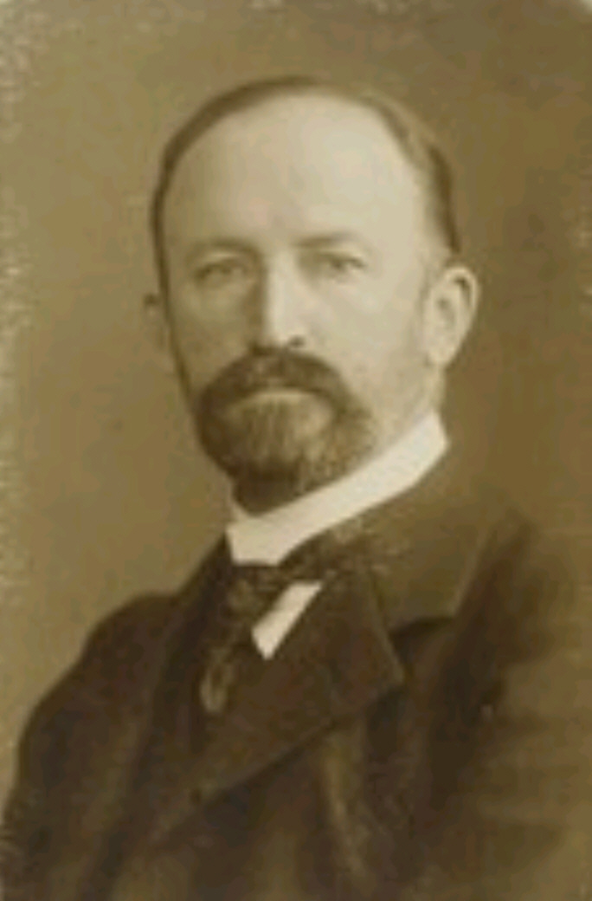
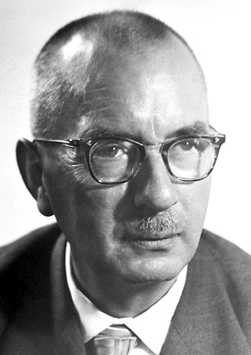
Dienone Phenol rearrangement
Karl Friedrich von Auwers (September 16, 1863 – May 3, 1939)
Karl Waldemar Ziegler (November 26, 1898 – August 12, 1973)
He was a German chemist
The dienone-phenol rearrangement is a reaction in organic chemistry first reported in 1921 by Auwers and Ziegler.
Karl Waldemar Ziegler won the Nobel Prize in Chemistry in 1963,
Karl Friedrich von Auwers
Karl Waldemar Ziegler

Slide 5
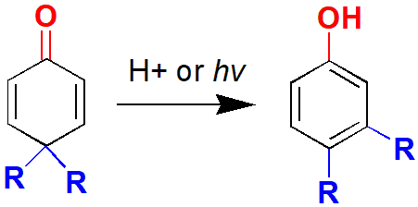
General Reaction
Dienone-phenol rearrangement is 4,4-disubstituted cyclohexadienone converting into a stable 3,4-disubstituted phenol in presence of acid.
presence of acid
4,4-disubstituted cyclohexadienone converts to 3,4‐disubstituted phenol

Slide 6
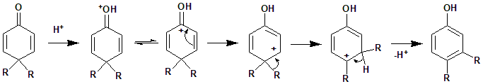
Mechanism
The reaction mechanism of 4,4-disubstituted cyclohexadienones to 3,4-disubstituted phenol is illustrated here

Slide 7
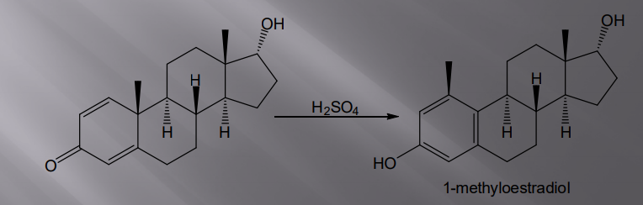
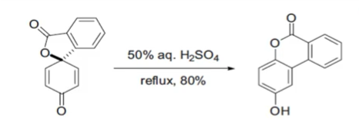
Applications
A particularly useful example of dienone-phenol rearrangement can be found in the syntheses of steroidal compound as shown below.

Slide 8
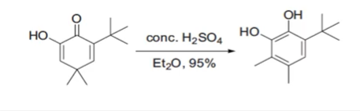
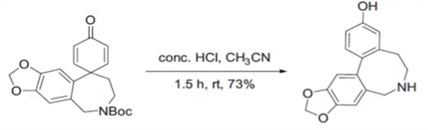

Slide 9
Credits
Wikipedia.org
organic reaction mechanisms v k Ahluwalia (Book)
chemistry.about.com
chem4kids.com

