Slide 1


HVHP Institute of Post Graduate Studies
and Research, Kadi
(A Constituent Institute of Kadi Sarva Vishwavidyalaya, Gandhinagar)
Mr. ViralKUMAR A. Patel
Benzilic acid Rearrangement reaction

Slide 2
Types of rearrangement reaction
Hofmann rearrangement
Beckmann rearrangement
Benzilic acid rearrangement
Claisen rearrangement
Fries rearrangement
Dienone Phenol
Wagner–Meerwein rearrangement
Curtius rearrangement
Schmidt reaction
Favorskii rearrangement

Slide 3
Content
Introduction
General Reaction,
Mechanism
Applications

Slide 4
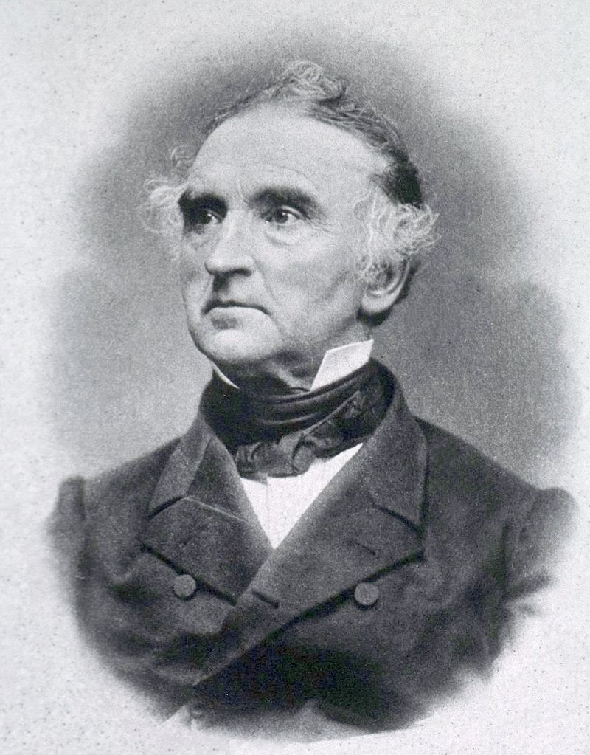
Benzilic acid rearrangement
Born- 12 May 1803 Germany,
Died- 18 April 1873 (aged 69) Germany,
He was a German scientist who made major contributions to agricultural and biological chemistry, and is considered one of the principal founders of organic chemistry.
Justus von Liebig

Slide 5
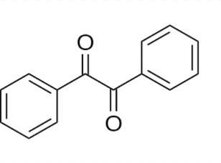
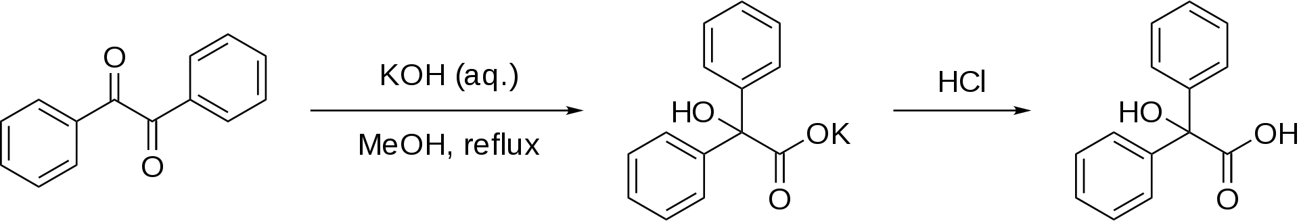
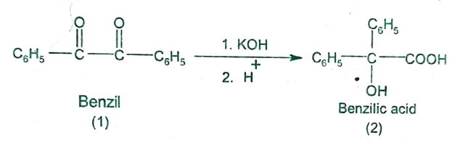
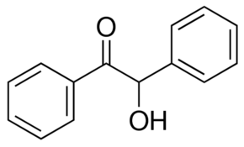
General Reaction
Benzil-Benzilic acid rearrangement
α-Diketones (benziles) undergo a base-catalysed reaction called benzil-benzilic acid rearrangement.
1,2 rearrangement of 1,2 Diketones into α-hydroxy carboxylic acids using a Base [KOH(aq) + Et-OH] Reflex [Temp.=100 °C]

Slide 7
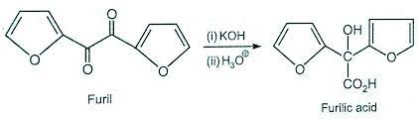
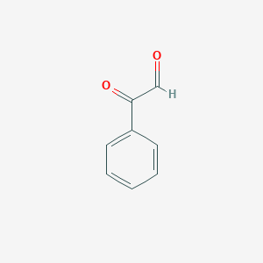
Furil Ferulic acid
CH3

Slide 8
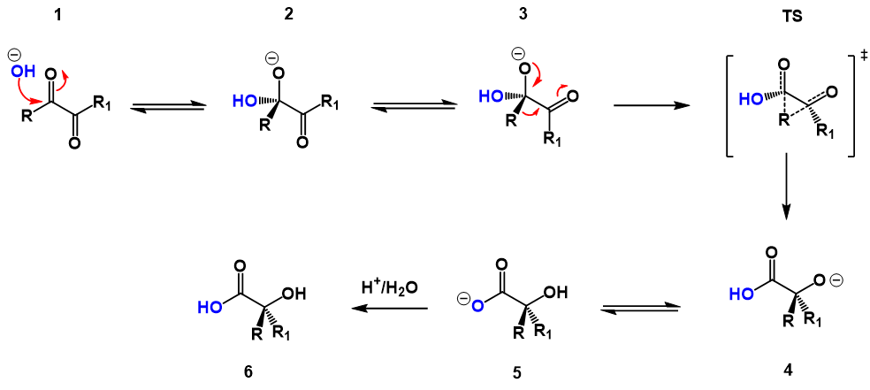
Mechanism

Slide 9
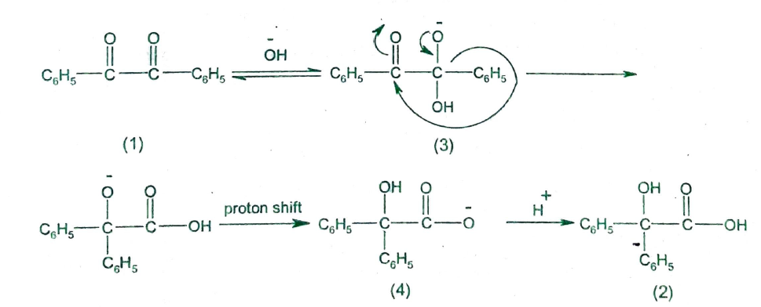

Slide 10
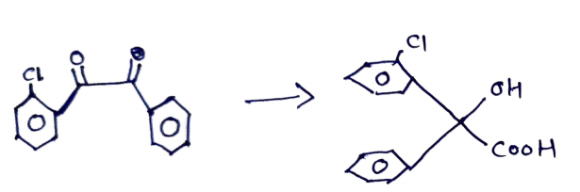

Slide 11

Applications
The benzil-benzilic acid rearrangement is particularly useful for the synthesis of citric acid from ketopinic acid.

Slide 12
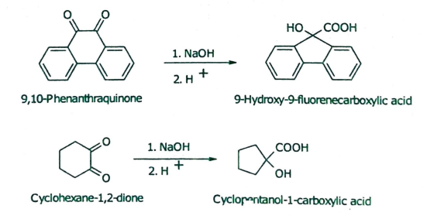
The benzilic acid rearrangements of 9,10 phenanthrenequinone and cyclohexane 1,2-dione.

Slide 13
Credits
Wikipedia.org
Organic reaction mechanisms v k Ahluwalia (Book)
Selman, S.; Eastham, J. (1960). “BENZILIC ACID AND RELATED REARRANGEMENTS”
Bowden, K.; Fabien, W. M. F. (2001). “Reactions of carbonyl compounds in basic solutions. Part 36:The base-catalysed reactions of 1,2-dicarbonyl compounds”
Gill, G. B. (1961). “Benzyl-benzilic acid rearrangements”

