Slide 1


HVHP Institute of Post Graduate Studies
and Research, Kadi
(A Constituent Institute of Kadi Sarva Vishwavidyalaya, Gandhinagar)
Mr. ViralKUMAR A. Patel
Beckmann
Rearrangement reaction

Slide 2
Types of rearrangement reaction
Hofmann rearrangement
Beckmann rearrangement
Benzilic acid rearrangement
Claisen rearrangement
Fries rearrangement
Dienone Phenol
Wagner–Meerwein rearrangement
Curtius rearrangement
Schmidt reaction
Favorskii rearrangement

Slide 3
Content
Introduction
General Reaction,
Mechanism
Applications

Slide 4
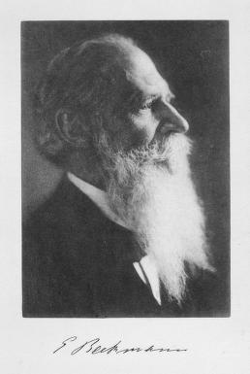
Beckmann rearrangement
Born- July 4, 1853 Germany,
Died- July 12, 1923 (aged 70) Germany,
He was a German pharmacist and chemist who is remembered for his invention of the Beckmann differential thermometer and for his discovery of the Beckmann rearrangement
Ernst Otto Beckmann

Slide 5
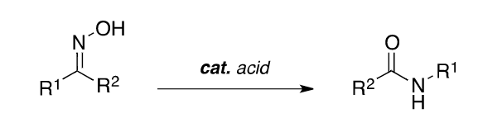
General Reaction
The acid-catalysed conversion of ketoximes to amides is
known as the Beckmann rearrangement
Conc.H2SO4, HCl, PCl5, PCl3, SOCl2, ZnO, SiO2, PPA
(Poly phosphoric acid) etc., are employed in Beckmann rearrangement.
acidic conditions
Oxime Amide

Slide 6
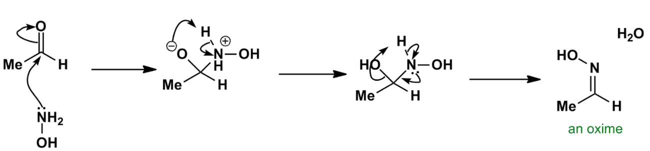
Mechanism
The first step in the process is formation of an oxime from the aldehyde or ketone,

Slide 7
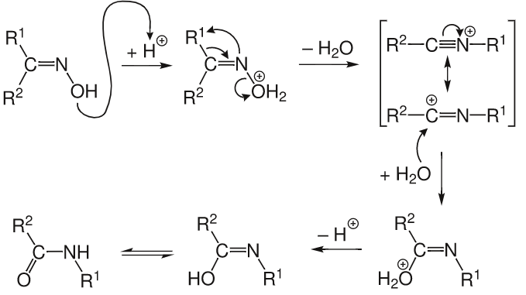
This rearrangement take place an alkyl migration with expulsion of the hydroxyl group to form a nitrilium ion followed by hydrolysis.

Slide 8
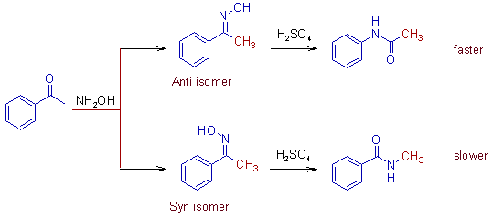
Migratory aptitudes
The relative migratory aptitudes of different groups in Beckmann rearrangement is illustrated below.
H
Ph
3°
2°
1°
Ph
H
3°
2°
1°

Slide 9
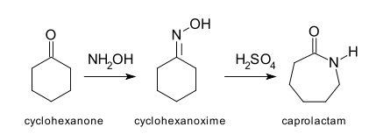
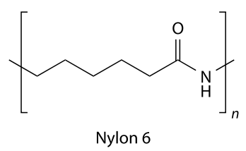
Applications
Synthesis of caprolactam from cyclohexanone oxime in presence of concentrated sulfuric acid. Caprolactam alkaline polymerization gives nylon.
Base

Slide 10
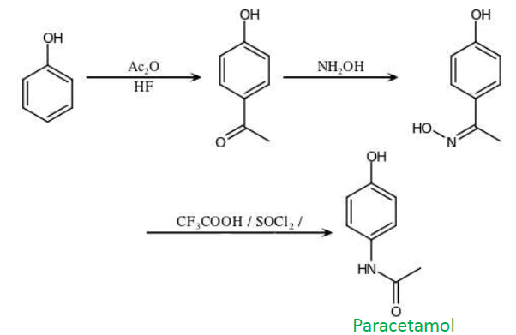
An alternative industrial synthesis method for Paracetamol

Slide 11
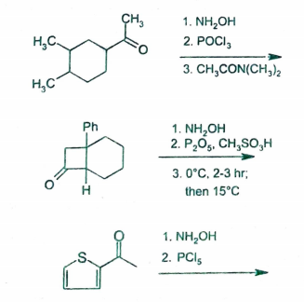
The Beckmann rearrangement is also used in the synthesis of
1. DHEA (Diethylaminosulfur trifluoride)
2. Benazepril
3. Etazepine etc.
Some other synthesis are given below

Slide 12
Credits
Wikipedia.org
organic reaction mechanisms v k Ahluwalia (Book)
chemistry.about.com
chem4kids.com

