Slide 1


HVHP Institute of Post Graduate Studies
and Research, Kadi
(A Constituent Institute of Kadi Sarva Vishwavidyalaya, Gandhinagar)
Mr. ViralKUMAR A. Patel
Claisen
Rearrangement reaction

Slide 2
Types of rearrangement reaction
Hofmann rearrangement
Beckmann rearrangement
Benzilic acid rearrangement
Claisen rearrangement
Fries rearrangement
Dienone Phenol
Wagner–Meerwein rearrangement
Curtius rearrangement
Schmidt reaction
Favorskii rearrangement

Slide 3
Content
Introduction
General Reaction,
Mechanism
Applications

Slide 4
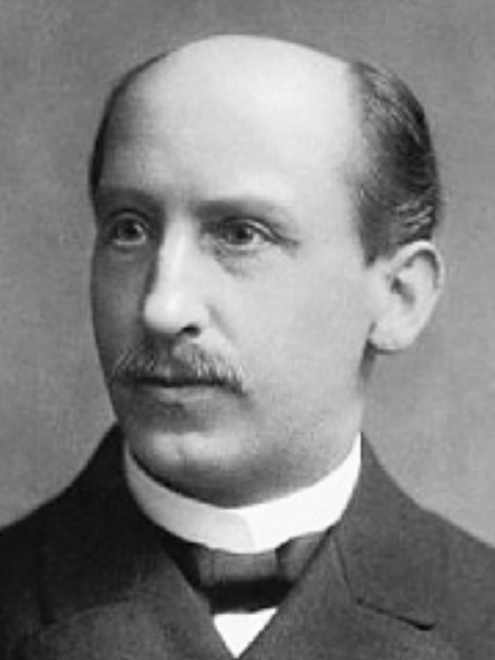
Claisen rearrangement
Born- 14 January 1851 (Cologne) Germany,
Died- 5 January 1930 (aged 78) Germany,
was a German chemist best known for his work with condensations of carbonyls and sigmatropic rearrangements.
The Claisen rearrangement is a powerful carbon–carbon bond-forming chemical reaction discovered by Rainer Ludwig Claisen.
Rainer Ludwig Claisen

Slide 5
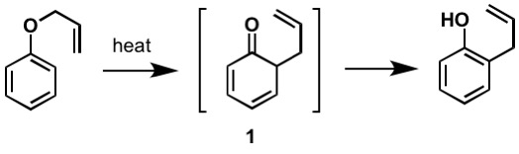
General Reaction
Rearrangement of allyl aryl ethers to o- or p-allylphenols is an example of sigmatropic rearrangement, and known as Claisen rearrangement’.
The allyl group migrates from oxygen to the ring preferably at ortho- position.
200 °C
Allyl phenyl ether converts to 2-allylphenol

Slide 6
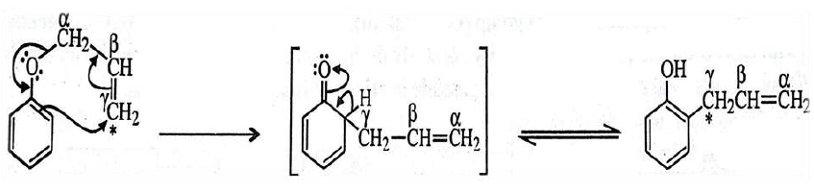
Mechanism
The cyclic mechanism, outlined below accounts for the intramolecular rearrangement of allyl ether to ortho allyl phenol.

Slide 7
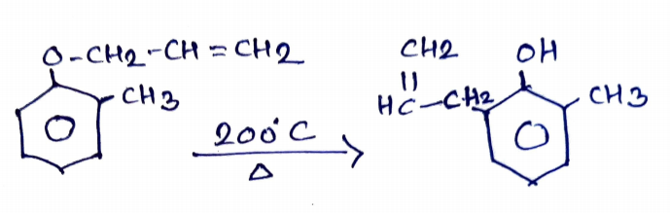
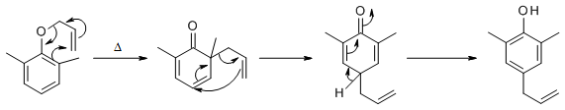
When the one ortho-position occupied by any substituted then rearrangements shift to another ortho-position.
When the both o-positions are blocked, p-substituted phenol is obtained via two successive shifts of allyl group.

Slide 8
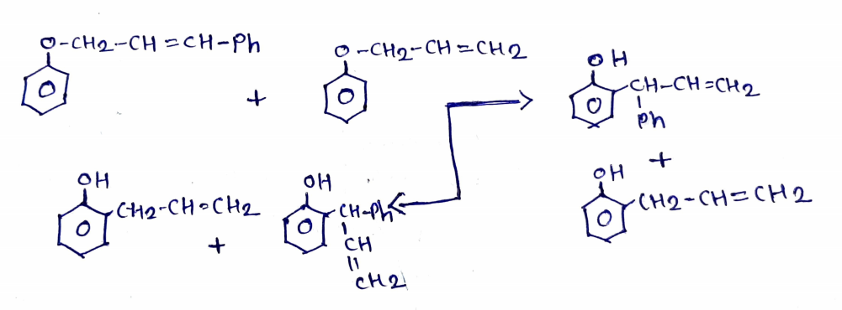
Claisen rearrangement is intramolecular in nature.

Slide 9
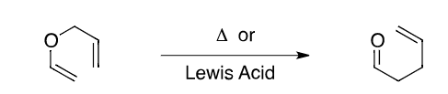
Applications
Allyl vinyl ether is converted into a γ,δ-unsaturated carbonyl compound with the input of heat or a Lewis acid.

Slide 10
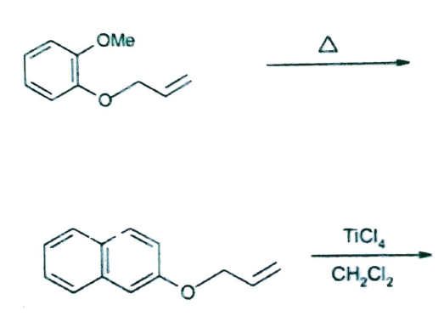
Some other synthesis are given below

Slide 11
Credits
Wikipedia.org
organic reaction mechanisms v k Ahluwalia (Book)
chemistry.about.com
chem4kids.com

